Slide 1

Global Business Challenge 2021
2021 CGMA 商业精英国际挑战赛
Team: Random Magic

Slide 2
Task ONE
PART I: Risk Analysis -- Private V.S. Company-issued Laptops
Can you please explain the key risks you believe we are exposed to by allowing our trainers to use their own laptop computers to deliver our training sessions?
Dzodzi Tsikata
Senior Finance Manager
1

Slide 3


TASK ONE
PART I: Risk Analysis -- Private V.S. Company-issued Laptops
The use of stand-alone computer impose risks to Trayyner.
Private Laptops V.S. Company-issued Laptops
Functionality Risk
Data Risk
Cyber Hacking Risk
Compliance Risk
Meaning
Security risks e.g. threats from hackers, such as malware
Exposure to legal penalties
e.g. use of illegal hardware and software
Failure to meet the users’ needs
e.g. frequently shut down
Loss of data
e.g. failure in storage
and use of data
Impact
Disruption of training
Data loss
Information leakage
Identity loss
Lawsuits
Reputation risk
Solution
Pre-testing
Custody of laptops
Data backup
Encrypt sensitive data
Access control
Antivirus
Firewall
Trainer education
Need an IT team to help
2

Slide 4

TASK ONE
PART I: Risk Analysis -- Private V.S. Company-issued Laptops
A qualitative risk assessment reveals that Trayyner is susceptible and vulnerable to IT risks.

The root causes are:
lack of support from top
management
 lack of internal control
Risk assessment matrix for Trayyner
 | Impact
Likelihood |  | Negligible | Low | Medium | High | Catastrophic
 | Catastrophic
 | High |  |  |  | Cyber Hacking risk
 | Medium |  | Functionality risk | Data risk
 | Low |  |  | Compliance risk
 | Negligible
NO!!!
Asif The executive chair of Trayyner
Functionality & Progress Tracking Risk
Meaning
3

Slide 5
TASK ONE
PART II: Discussion on Establishing a Separate,
Permanent, and Well-resourced IT Function
Discuss the business case for establishing a separate, permanent, and well-resourced IT function based at Head Office that can support the activities of our operations.
Dzodzi Tsikata
Senior Finance Manager
4

Slide 6
TASK ONE
PART II: Discussion on Establishing a Separate,
Permanent, and Well-resourced IT Function
Non-financial perspective
IT function provide support, assistance and advices to Trayyner……
CEO
IT
Course Management
Global
Marketing
Administration and accounting
System and data back-up
Physical security to prevent unauthorized access
Deal with emergency
Improve data sharing capability
Improve the knowledge base of course manager
Better understanding of prospective employers’ needs
Tailor bespoken courses for employers
Support the maintenance of cloud-based accounting
Facilitate billing/ invoicing and receivable management
5
Notes:
AR技术可以辅助课程进行

Slide 7
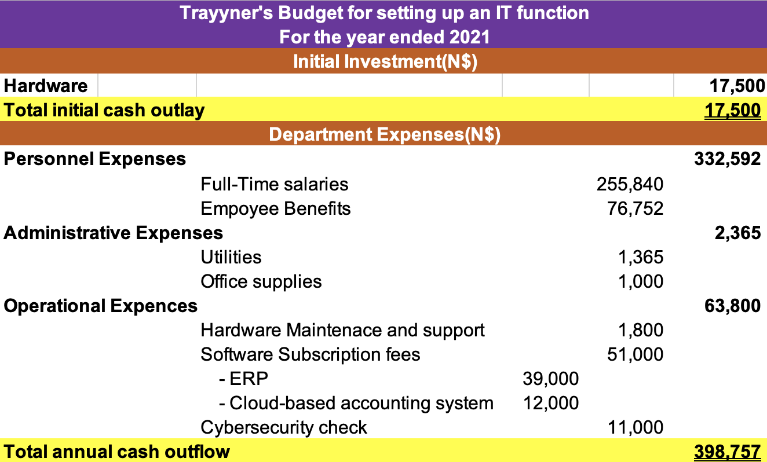
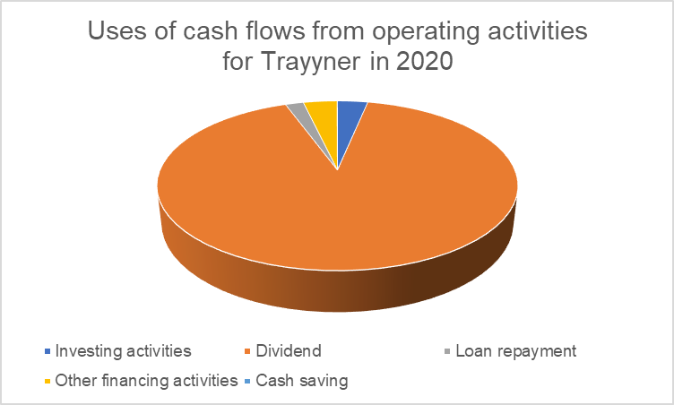
TASK ONE
PART II: Discussion on Establishing a Separate,
Permanent, and Well-resourced IT Function
Financial perspective
Setting up an IT function required
an initial cash outlay of N$17,500
an annual cash outflow of N$398,757
Trayyner has difficulties in repaying the immediate debt (Current ratio in 2020 - 0.11: 1), despite its strong operating cash flow of N$46,492,000
2020 Trayyner’s financial position
Major use of cash – Cash Dividend (91%)
Trayyner's IT Function Budget
6

Slide 8

TASK ONE
PART II: Discussion on Establishing a Separate,
Permanent, and Well-resourced IT Function
Trayyner should finance the project using internal financing.
Plowing back its retained earnings
Rationale:
Sustainable growth - to make efficient use of earnings as 95.04% of profit was paid out as dividend in 2020
Less costly compared with other means, e.g. the use of long-term borrowing will further increase the leverage (Debt-to-asset ratio in 2020 - 0.46), and cost of debt
Trayyner's IT Function Budget
7

Slide 9

TASK TWO
An Upset Delegate
Yesterday I attended your training course.
It was the first time I have attended a course of this nature.
And it will be my last!
I really don’t know the value of attending such courses.
I am utterly disappointed!
Nadia Wali
A Delegate of Oil & Gas Engineering Division
8

Slide 10


TASK TWO
Part I: Executive Training’s Value on Employers
Add new skills
Familiarize with the jobs
Integrate into the company culture
To prepare delegates for the leadership role:
- conceptual skills
decision-making skills
generic skills
To obtain necessary information for new job assignment:
- competitive landscape - macro-environment
To integrate into the company culture and influence the alignment:
- strategy
culture
Training gap
Without formal education in accounting
Lack up-to-date knowledge and information
Not able to drive the change
EPS?
Risk Management?
Modernize the culture?
Finance director Eastland Telecommunication
Newly appointed director Oil company
Chief Executive Officer Eastland Telecommunication
Training
program
Accounting and Finance:
Understanding IFRS
Health and safety:
Risk and incident analysis
Change Management:
Best practices on change
9

Slide 11

TASK TWO
Part II: Range of Metrics when Selecting Hotels
1 2 3
Problem
identification
Criteria
Development
Evaluation
Select a venue for conducting classes
Develop criteria for selecting hotel, including:
Past experience — delegates’ satisfaction
Convenience — proximity to delegates and trainers
Good services — conference and meeting facilities and other amenities
(Source: Journal of Vacation Marketing)
Post-purchase evaluation on existing venue:
- conference facilities : bad
- gym equipment : dirty and old
- spa facilities : closed
- room : uncomfortable
- breakfast : poor standard
10

Slide 12
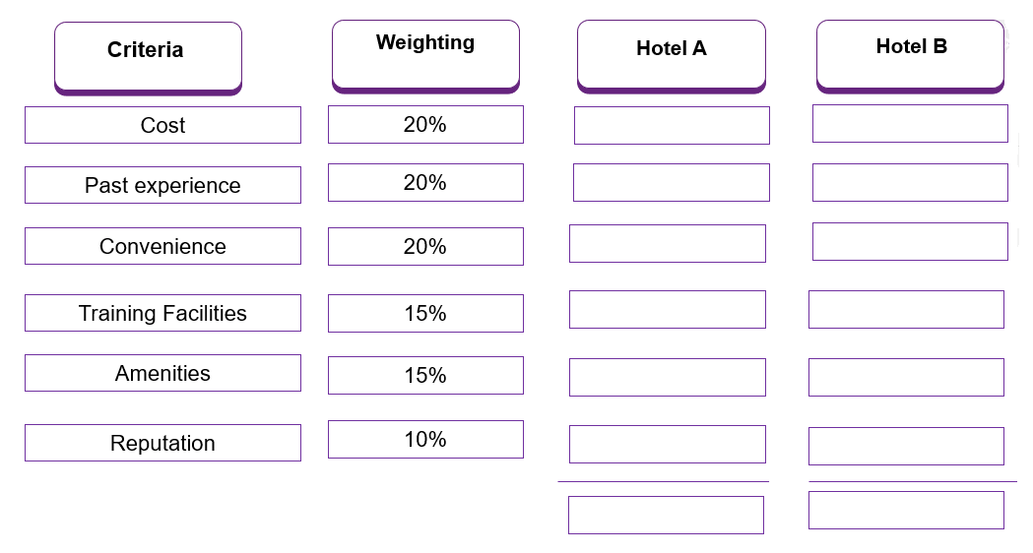





TASK TWO
Part II: Range of Metrics when Selecting Hotels
Decide on which hotel to patronize according to the evaluation result
11

Slide 13


TASK TWO
Part III: Reasons for More Attention on Delegate Diversity
Delegates are indispensably involved in the training process. Their interactions are hindered because……
Divergent belief and value among delegates
take trainees to watch football after class without their permission
consume alcohol in hub regardless of trainee’s religious belief
Conflicts between delegates
misogynistic gathering of comments, jokes
“banter” at pub
12

Slide 14
TASK TWO
Part III: Reasons for More Attention on Delegate Diversity
The diversity of delegates imposes threats and opportunities for Trayyner……
Class engagement
Image
Training needs
Undermine the trust among delegates
Hinder delegates’ active participation and interaction
Ruin the image of the training center
“I expected better of a company with Trayyner’s reputation. What a shame.”
Raise awareness on diversity and inclusion
Aware of unconscious bias and discrimination
Threats
Opportunities
13

Slide 15
TASK TWO
Part III: Reasons for More Attention on Delegate Diversity
The diversity of delegates imposes threats and opportunities for Trayyner……
Class engagement
Image
Training needs
Undermine the trust among delegates
Hinder delegates’ active participation and interaction
Ruin the image of the training center
“I expected better of a company with Trayyner’s reputation. What a shame.”
Raise awareness on diversity and inclusion
Aware of unconscious bias and discrimination
Threats
Opportunities
13

Slide 16
TASK THREE
Settle Cultural and Financial problems for Nancy
What will be the main challenges if I want to transform the parastatal corporate culture into a more private one?
What is EPS?
Nancy
Chairperson of the Eastland Telecommunications Corporation
14

Slide 17



TASK THREE
Part I: Changing the culture
There is culture transformation after the privatization…..
Parastatal
Private
Mean: provide social services which meet the budget
Orientation: less responsive to market
Mechanistic structure: more bureaucracy
Mean: select the project on the commercial basis
Orientation: more responsive to stakeholders
Organic structure: less red-tape
Eastland
Telecommunications
Corporation
Provide telecommunication services for the public regardless of profits
Maximize the earnings per share
National interest
Shareholders’ interest
15

Slide 18
TASK THREE
Part I: Changing the culture
There is culture transformation after the privatization…..
Parastatal
Private
Mean: provide social services which meet the budget
Orientation: less responsive to market
Mechanistic structure: more bureaucracy
Mean: select the project on the commercial basis
Orientation: more responsive to stakeholders
Organic structure: less red-tape
Eastland
Telecommunications
Corporation
Provide telecommunication services for the public regardless of profits
Maximize the earnings per share
National interest
Shareholders’ interest
15

Slide 19




TASK THREE
Part I: Changing the culture
The major challenge is the resistance from employees at all levels.
Possible consequence:
Fear of loss
Uncertainty avoidance
Frustration
Fear of loss of power, status and job security
Potential risks to be replaced
Fear of unknown
Sensitive to the changes
Less receptive to the change
Not accustomed to the new culture
Lack of commitment
Inertia
Difficult to understand to culture after the transformational change
Used to do things in their own ways
Stick to original working pattern
16

Slide 20
TASK THREE
Part I: Changing the culture
The major challenge is the resistance from employees at all levels.
Possible consequence:
Fear of loss
Uncertainty avoidance
Frustration
Fear of loss of power, status and job security
Potential risks to be replaced
Fear of unknown
Sensitive to the changes
Less receptive to the change
Not accustomed to the new culture
Lack of commitment
Inertia
Difficult to understand to culture after the transformational change
Used to do things in their own ways
Stick to original working pattern
16

Slide 21
TASK THREE
Part I: Changing the culture
The major challenge is the resistance from employees at all levels.
Possible consequence:
Fear of loss
Uncertainty avoidance
Frustration
Fear of loss of power, status and job security
Potential risks to be replaced
Fear of unknown
Sensitive to the changes
Less receptive to the change
Not accustomed to the new culture
Lack of commitment
Inertia
Difficult to understand to culture after the transformational change
Used to do things in their own ways
Stick to original working pattern
16

Slide 22
TASK THREE
Part I: Changing the culture
The major challenge is the resistance from employees at all levels.
Possible consequence:
Fear of loss
Uncertainty avoidance
Frustration
Fear of loss of power, status and job security
Potential risks to be replaced
Fear of unknown
Sensitive to the changes
Less receptive to the change
Not accustomed to the new culture
Lack of commitment
Inertia
Difficult to understand to culture after the transformational change
Used to do things in their own ways
Stick to original working pattern
16

Slide 23
TASK THREE
Part II: Earnings Per Share (EPS)
After privatization, Eastland Telecommunications Corporation become a public corporation.
Reporting requirement:
Basic and diluted EPS has to be presented in the statement of comprehensive income
EPS
=
Net Income –
Preference Dividends
Impact of Convertibles
Impact of Options, Warrants, and Other Dilutive Securities
-
-
Weighted-Average
Shares Outstanding
Basic EPS
Diluted EPS
17

Slide 24
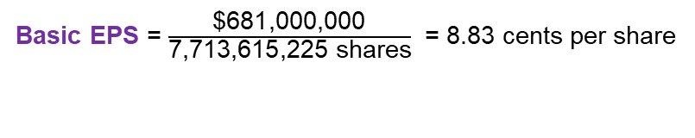
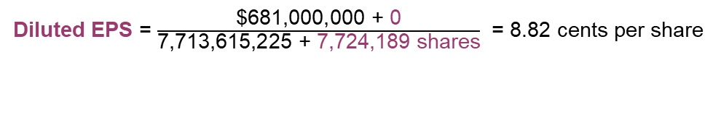
TASK THREE
Part II: Earnings Per Share
Selected data for the calculation of basic and diluted EPS for PCCW limited were presented as below:
Earnings Net income …………………………………. $681,000,000
Number of shares
Weighted average number of shares……. 7,713,615,225 shares
Effect of shares awarded under shares award scheme……………………………. 7,724,189 shares
Consolidated income statement
For the year ended December 31, 2020
Revenue ………………………………............. Cost of sales………………………………….....
General and administrative expenses…………
Other gains/ (losses)…………………………….
Finance costs ……………………………………
Profit before income tax………………………..
Income tax………………………………………
Profit for the year ……………………………..
Profit/ (Loss) attributable to
Equity holders of the company……………
Non-controlling interest…………………...
Earnings/ (Loss) per share
Basic ……………………………………… 8.83 cents
Diluted ………………………………....... 8.82 cents
For Eastland Telecommunications Corporation (ETC),
any discontinued operations? Not certain
any convertible instruments? A convertible loan note to finance installation of new optical cable links
18

Slide 25
TASK FOUR
Part I: Risk Management Process
What is the content of an effective
risk management process that would
be suitable for the my company to adopt?
Please include the various activities
at different stages.
Nancy
Chairperson of the Eastland Telecommunications Corporation
19

Slide 26
TASK FOUR
Part I: Risk Management Process
An Effective Risk Management Process:
Risk Identification
Risk Measurement
Risk Treatment
Implementation
Follow-up
PESTLE Analysis
Structured checklist
Physical inspection
Quantitative risk assessment
Risk matrix diagram
Develop risk management strategies
Appropriate Actions
Monitor
Review & Report
20

Slide 27

TASK FOUR
Part I: Risk Management Process
PESTLE Analysis for
Eastern Telecommunication Corporation
Risk Identification
Political:
Network licensing regulations
National security and human rights issues
Technological:
Cloud computing
5G Competition
Risk Measurement
Legal:
On changing broadcasting regulations
Globally legal compliance
Risk Treatment
Economic:
Recession → Telecom spending cutbacks
Implementation
Social:
Booming social media and online platforms
Environmental:
E-waste Management
Follow-up
21

Slide 28
TASK FOUR
Part I: Risk Management Process
Risk Matrix Diagram
Risk Identification
 | Impact
Likelihood |  | Negligible | Low | Medium | High | Catastrophic
 | Catastrophic
 | High |  |  |  | Regulation risk
 | Medium |  |  | Loss of significant customers | Loss of sales due to macro factors
 | Low |  |  |  |  | Property risk
 | Negligible
Risk Measurement
Risk Treatment
Implementation
Follow-up
22

Slide 29
TASK FOUR
Part I: Risk Management Process
4Ts for Risk Treatment:
Risk Identification
Tolerate: set aside a reserve fund
e.g. Loss of sales due to macro-factors -
self-insurance to absorb the loss
Transfer: take out insurance policy to shift the risks to third parties
e.g. property risk – transfer the risks by taking out a property insurance
Risk Measurement
Risk Treatment
Treat: carry out risk control measures
e.g. Loss of significant customers – implement a well-designed CRM system
Terminate: not engage in certain activity
e.g. regulation risk - abstain from serving certain countries in which 5G technology is banned
Implementation
Follow-up
23
Notes:
1: transfer out using insurance; 2: treat by adjusting investment strategy

Slide 30
TASK FOUR
Part I: Risk Management Process
Implementation:
Risk Identification
Put the risk management plan into practice
Follow-up:
Risk Measurement
Risk Treatment
Monitor
Monitoring evolving developments in its operating environment
Review
Assess effectiveness and make necessary improvements
Report
Ensure accountability and assist decision making in the future
Implementation
Follow-up
Oversight responsibilities: Risk Management, Controls and Compliance Committee
24
Notes:
Effective risk management is a continuous, ongoing process, not a one-off exercise.

Slide 31
TASK FOUR
Part II: Actions for changing culture challenges
Can you please recommend what
actions could I take to overcome
the challenges of changing and
modernizing culture
at the corporation?
Nancy
Chairperson of the Eastland Telecommunications Corporation
25

Slide 32
TASK FOUR
Part II: Actions for changing culture challenges
Actions to overcome the changing culture challenges:
Create a climate for change
Leader as champions
Tracking cultural change
Private
Culture
Employee engagement
Training recognition and rewards
Team orientation
26
Notes:
Previously we have identified the biggest challenge for culture change is the resistance from employees, therefore…

Slide 33
TASK FOUR
Part II: Actions for changing culture challenges
The keys to transformational change are to deliver a strong and coherent message to staff….
Climate for change
Leaders as champions
Create a climate for change
Free talks and Seminars
Leaders:
Drive the changes
Strategic leadership
Leader as champions
Tracking cultural change
Private
Culture
Employee engagement
Team orientation
More effective feedback channels
Flatter organization
Across departments
Employee engagement
Recognition and rewards
Work on their key concerns
Team orientation
27
Notes:
To deliver a strong and coherent message to staff, ……

Slide 34
TASK FOUR
Part II: Actions for changing culture challenges
The key to transformational change is to deliver a strong and coherent message to staff….
Climate for change
Leaders as champions
Create a climate for change
Free talks and Seminars
Leaders:
Drive the changes
Strategic leadership
Leader as champions
Tracking cultural change
Private
Culture
Employee engagement
Team orientation
More effective feedback channels
Flatter organization
Across departments
Employee engagement
Recognition and rewards
Work on their key concerns
Team orientation
27
Notes:
To deliver a strong and coherent message to staff, ……

Slide 35
TASK FOUR
Part II: Actions for changing culture challenges
The key to transformational change is to deliver a strong and coherent message to staff….
Climate for change
Leaders as champions
Create a climate for change
Free talks and Seminars
Leaders:
Drive the changes
Strategic leadership
Leader as champions
Tracking cultural change
Private
Culture
Employee engagement
Team orientation
More effective feedback channels
Flatter organization
Across departments
Employee engagement
Recognition and rewards
Work on their key concerns
Team orientation
27
Notes:
To deliver a strong and coherent message to staff, ……

Slide 36
TASK FOUR
Part II: Actions for changing culture challenges
The key to transformational change is to deliver a strong and coherent message to staff….
Climate for change
Leaders as champions
Create a climate for change
Free talks and Seminars
Leaders:
Drive the changes
Strategic leadership
Leader as champions
Tracking cultural change
Private
Culture
Employee engagement
Team orientation
More effective feedback channels
Flatter organization
Across departments
Employee engagement
Recognition and rewards
Work on their key concerns
Team orientation
27
Notes:
To deliver a strong and coherent message to staff, ……

Slide 37
TASK FOUR
Part II: Actions for changing culture challenges
The keys to transformational change are to …… to provide a supportive environment.
Recognition and Rewards
Create a climate for change
Benchmarking – provide existing staff with realistic target
Leader as champions
Tracking cultural change
Private
Culture
Tracking cultural change
Keep active monitoring:
Employee feedbacks
Operations performance
Be Patient !
Employee engagement
Recognition and rewards
Team orientation
28
Notes:
Setting incentives and rewarding employees who is active in putting forward suggestions will stimulate their enthusiasm, making the company culture more dynamic.

Slide 38
TASK FOUR
Part II: Actions for changing culture challenges
The keys to transformational change are to …… to provide a supportive environment.
Recognition and Rewards
Create a climate for change
Benchmarking – provide existing staff with realistic target
Leader as champions
Tracking cultural change
Private
Culture
Tracking cultural change
Keep active monitoring:
Employee feedbacks
Operations performance
Be Patient !
Employee engagement
Recognition and rewards
Team orientation
28
Notes:
Setting incentives and rewarding employees who is active in putting forward suggestions will stimulate their enthusiasm, making the company culture more dynamic.

Slide 39
Appendix
Financial Analysis
Profitability ratios in 2019
 | Trayyner | Masterkles | Industry Average*
Gross Margin | 62.49% | 61.34% | 52.38%
Operating Margin | 56.84% | 55.68% | 7.24%
Net Margin | 45.94% | 45.00% | 10.13%
Profitability:
Higher earning capacity
Liquidity:
Difficulties in repaying the immediate debts
Liquidity ratios in 2019 and 2020
 | Trayyner |  | Masterkles
 | 2020 | 2019 | 2020 | 2019
Current Ratio | 0.11 :1 | 0.13:1 | 0.11 : 1 | 0.12 : 1
Solvency:
Able to meet the financial obligations
Solvency ratios in 2019 and 2020
 | Trayyner |  | Masterkles
 | 2020 | 2019 | 2020 | 2019
Interests coverage ratio | 941.97 times | 461.50 times | 832.91 times | 423.01 times
Debt to equity ratio | 0.87 | 0.83 | 0.93 | 0.95
Debt to Assets ratio | 0.46 | 0.45 | 0.48 | 0.49
29

Slide 40
Appendix
Trayyner Statement of Cash Flows
 | N$ thousand | N$ thousand
Cash flow from operating activities
Net income | 44,602
Increase in trade receivable | (13)
Increase in trade payable | 15
Increase in tax payable | 1,888 | 46,492
Cash flow from investing activities
Property, plant and equipment (Net) | (1,534)
Intangible assets (Net) | 25 | (1,509)
Cash flow from financing activities
Dividend | (42,390)
Repayment of borrowings | (900)
Foreign reserve | (1,677) | (44,967)
Increase in cash |  | 16
Cash balance as at 31 Dec 2019 ………………………………….. |  | 396
Cash balance as at 31 Dec 2020 ………………………………….. |  | 412
For the year ended 31 Dec 2020
30

Slide 41
Reference
C, Cooke (2020). Diversity & inclusion is imperative now and always. Retrieved from: https://www.cimaglobal.com/Members/Insights/2020-CIMA-Insights/Diversity-and-inclusion-is-imperative-now-and-always/
CSIMarket (2020). Educational Services Industry Profitability. Retrieved from: https://csimarket.com/Industry/industry_Profitability_Ratios.php?ind=903
Deloitte (2021). IAS33 Earnings per share. Retrieved from: https://www.iasplus.com/en/standards/ias/ias33
IFRS(2021). IAS33 Earnings per share. Retrieved from: https://www.ifrs.org/issued-standards/list-of-standards/ias-33-earnings-per-share/
Institute of Risk Management (2021). IRM Risk Predictions. Retrieved from https://www.theirm.org/news/irm-risk-predictions-2020/
O. O’Donnell and R. Boyle (2008). Understanding and managing organisational culture. Retrieved from: https://www.ipa.ie/_fileUpload/Documents/CPMR_DP_40_Understanding_Managing_Org_Culture.pdf
PCCW’s Annual Report (2020). Retrieved from http://www.pccw.com/staticfiles/PCCWCorpsite/About%20PCCW/Investor%20Relations/Announcements%20&%20Notices/2021/Mar/e01_Annual%20Report.pdf
S. W. Chan, and C. K. Wong (2006). Hotel selection: When price is not the issue. Journal of Vacation Marketing, 12(2): 142-159. Retrieved from https://journals.sagepub.com/doi/10.1177/1356766706062154

